Slide 1



Slide 2
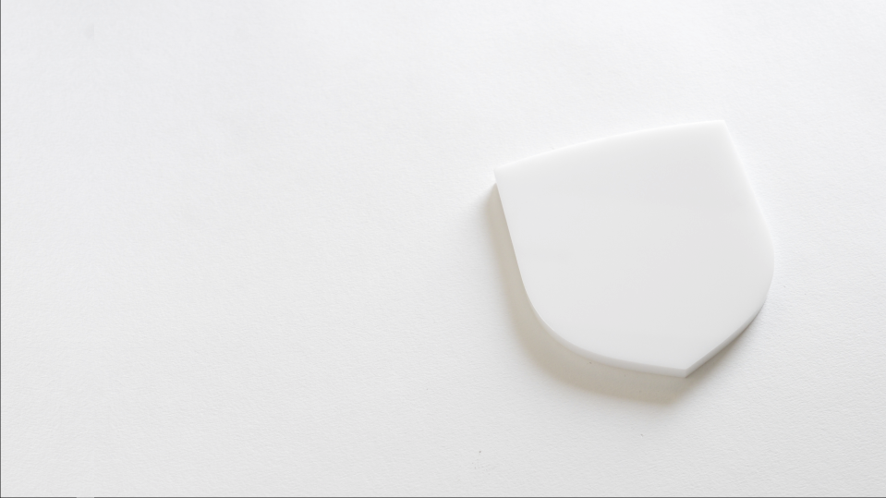


01CE1301 – Data Structure
Unit - 2
Linear Data Structure & their presentation
(Part 01 - Array)
Prof. Chirag Bhalodia
Computer Engineering Department

Slide 3
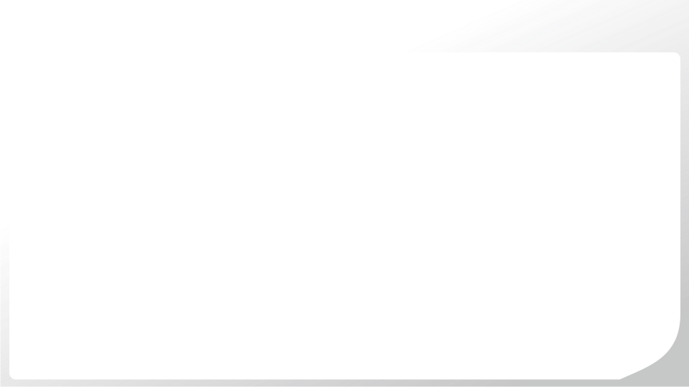
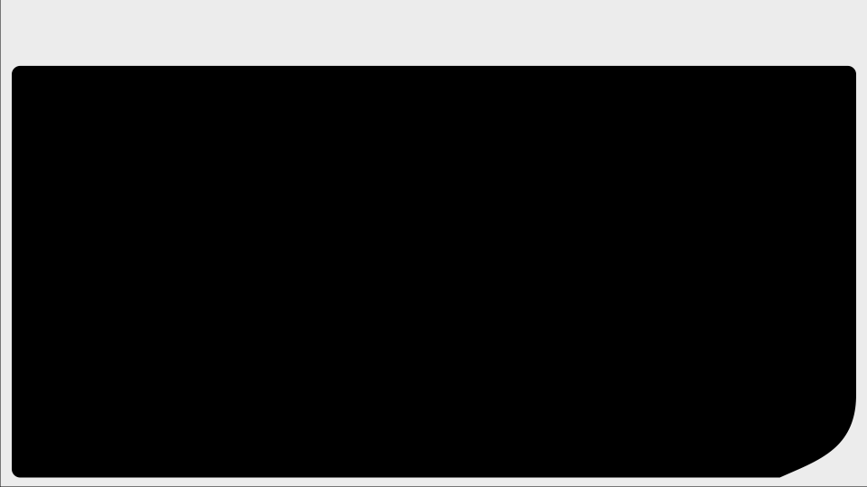
Outline
Representation of Arrays & storage structure
Sparse matrix and its representation
Application of Arrays

Slide 4

Representation of Arrays & storage structure

Slide 5
Representation of Arrays
What is Array?
An array is a collection of elements of the same data types.
Number of memory locations is sequentially allocated to the array.
A array size is fixed and therefore requires a fixed number of memory locations.
Two types of Array
1-Dimension Array
Multi Dimension Array

Slide 6
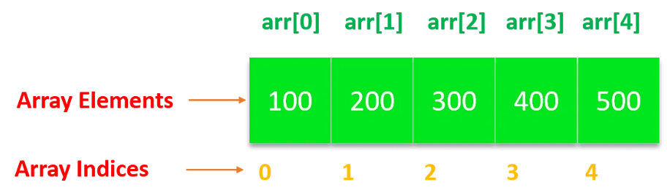
1-Dimensional Arrays
1-D Array
Single dimensional array or 1-D array is the simplest form of array.
This type of array consists of elements of similar types and these elements can be accessed through their indices.

Slide 7
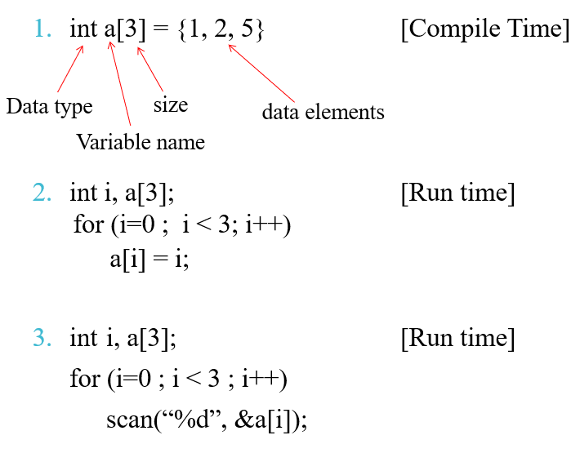
1-Dimensional Arrays
Declaration and Storing Array Elements

Slide 8
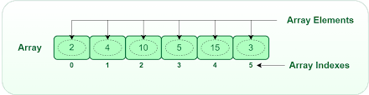
1-Dimensional Arrays
Store array elements
for (i = 0; i < n; i++)
{
scanf("%d", &a[i]);
}
Display
for (i = 0; i < n; i++)
{
printf("%d ", a[i]);
}

Slide 9
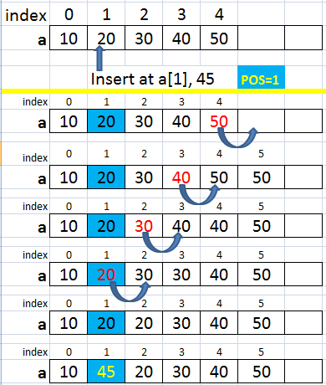
1-Dimensional Arrays
Insert elements at any position
n=n+1; //n=size of array
for(i = n-1; i >= pos; i--)
{
a[i]=a[i-1];
}
a[pos-1]=x; //x=element

Slide 10
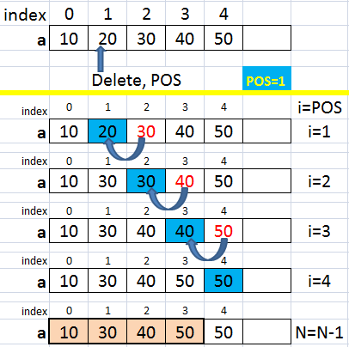
1-Dimensional Arrays
Delete an element
for (i = pos - 1; i < num -1; i++)
{
arr[i] = arr[i+1]; // assign arr[i+1] to arr[i]
}
POS = 2

Slide 11
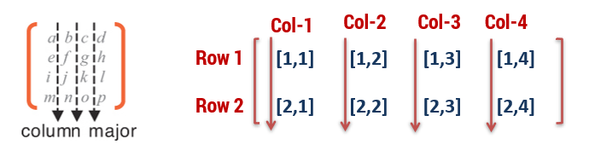
2-Dimensional Arrays
2-D Array
Two dimensional arrays are also called table or matrix
Two dimensional arrays have two subscripts.
Column major order matrix: Two dimensional array in which elements are stored column by column is called as column major matrix
Two dimensional array consisting of two rows and four columns is stored sequentially by columns :
A[1,1], A[2,1],
A[1,2], A[2,2],
A[1,3], A[2,3],
A[1,4], A[2,4]

Slide 12
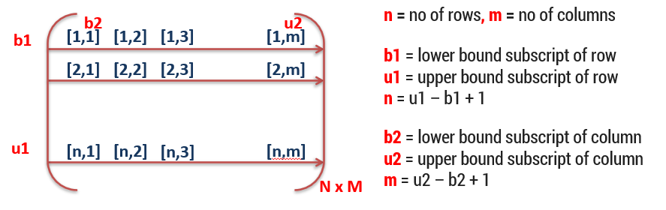
2-Dimensional Arrays
2-D Array
Row major order matrix: Two dimensional array in which elements are stored row by row is called as row major matrix.

Slide 13
Operations of Arrays
Operation on Arrays
Insertion of elements
Deletion of elements
Traversal
Searching
Merging

Slide 14
Sparse matrix and its representation

Slide 15
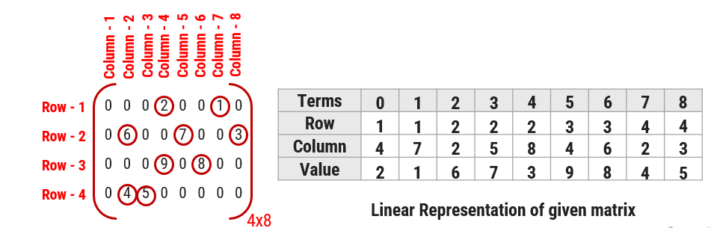
Spars Matrix and its representation
An m x n matrix is said to be sparse if “many” of its elements are zero.
A matrix that is not sparse is called a dense matrix.
Example:

Slide 16
Polynomial matrix and its representation
Matrix representation of polynomial equation
We can use array for different kind of operations in polynomial equation such as addition, subtraction, division, differentiation etc…
Array can be used to represent Polynomial equation.

Slide 17
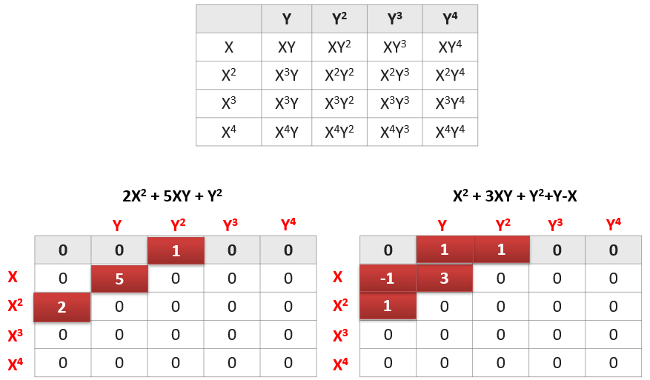
Polynomial matrix and its representation
Example:

Slide 18
Application of Arrays

Slide 19
Application of Arrays
To perform arithmetic operation on polynomial equation.
Widely used to implement mathematical vectors, matrices and other kinds of rectangular tables.
Used to implement stack, queue, heap, hash table, string, etc..
Can be used for dynamic memory allocation.

Slide 20

Thank
You

